Slide 1

Bug Life Cycle

Slide 2
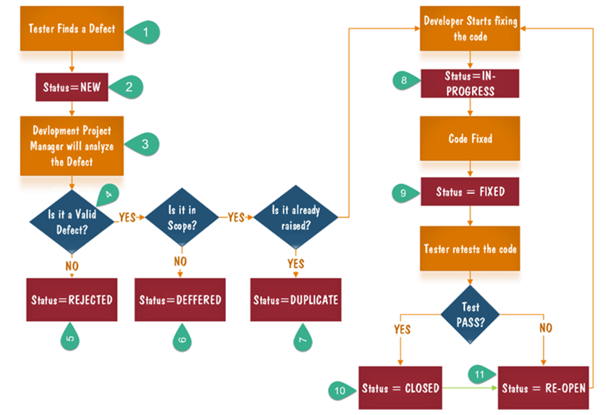

Slide 3
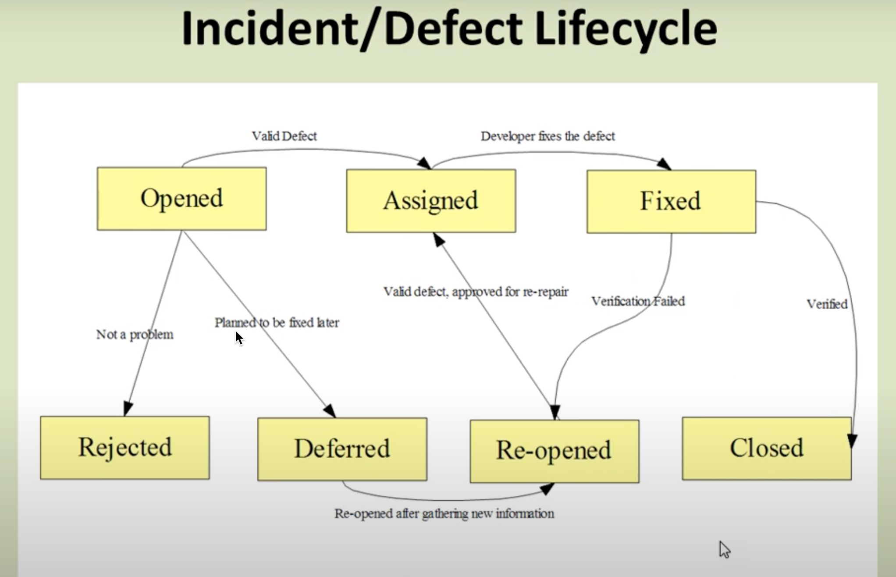

Slide 4
Bug Reporting
The standard format of bug reporting includes following 3 points.
Steps to replicate
Current Behavior
Expected Behavior

Slide 5
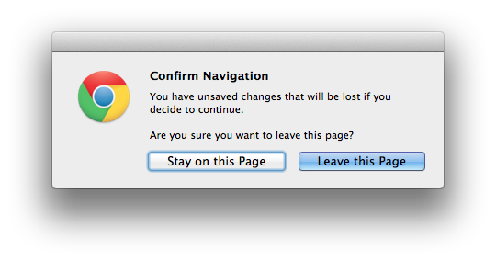
Example
Steps to replicate
Click on profile from the top right corner
Update the information on the profile page
Click on Refresh icon from browser or navigate back.
Current Behavior
The page gets reloaded without any confirmation when there are unsaved info in profile page.
Expected Behavior
As shown in the screenshot, a pop-up confirmation message must be there, if users try to reload the page when there are unsaved informations.

Slide 6
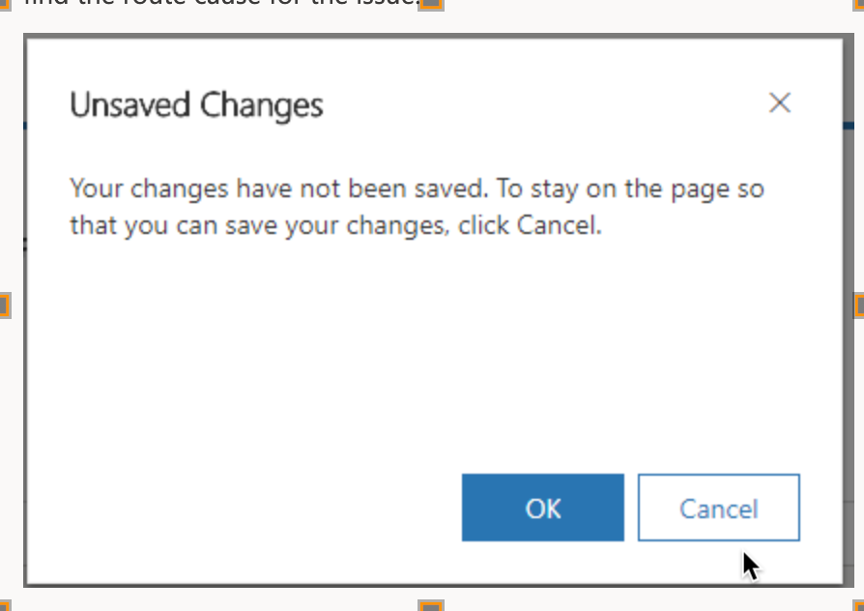

Slide 7
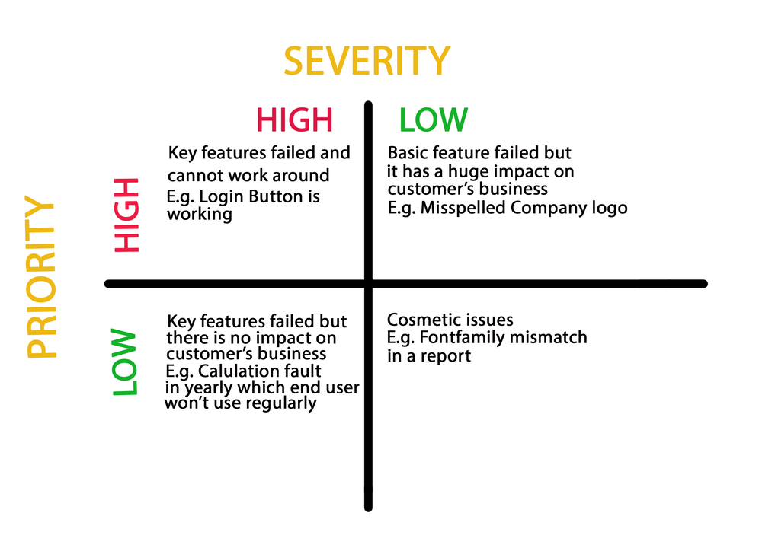

Slide 8


Low Priority And Low Severity
we have bug on page which is have very less hit i.e. rarely, then we can say it as low severity, low priority defect.
Any cosmetic or spelling issues which is within a paragraph or in the report

Slide 9
High Priority AND Low Severity
If the company name is misspelled in the home page of the website, then the priority is high and severity is low to fix it.
In that ATM facility
whenever we are withdrawing money it is not showing any conformation message but actually at the back end it is happening properly without any mistake means only message is missing,
in this case as it is happening properly so there is nothing wrong with the application but as end user is not getting any conformation message so he/she will be Confuse for this.

Slide 10
Low Priority and High Severity
Suppose we have banking application which calculate Yearly, Monthly and Weekly interest.
But we have error in Yearly calculation then we can say it as HIGH SEVERIRTY and LOW priority
Coz we can fix it in next week as well.

Slide 11
High Priority AND High Severity
User authentication failure.
System crash during data processing
user is not able to login to the application
doesn't allow to save the the on add/edit page

